Slide 1
Mathematical Foundations for Data Science
MFDS Team

Slide 2
DSECL ZC416, MFDS
Lecture 0

Slide 3
Agenda
Matrices and their types
REF and RREF
Rank, its computation and properties
Determinant, its computation and properties
Consistency and inconsistency of linear systems
Significant digits and rounding arithmetic

Slide 4
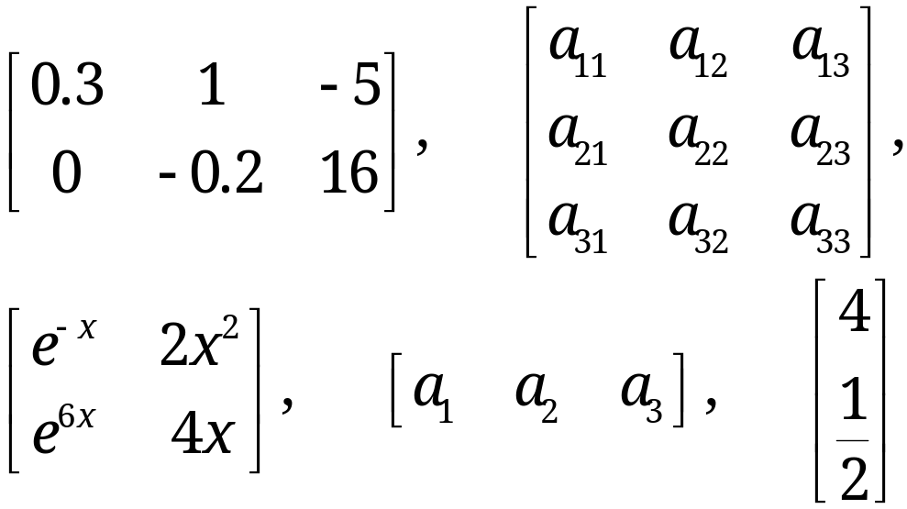
Matrices
A matrix is a rectangular array of numbers or functions which we will enclose in brackets. For example,
(1)
The numbers (or functions) are called entries or, less commonly, elements of the matrix.
The first matrix in (1) has two rows, which are the horizontal lines of entries.

Slide 5
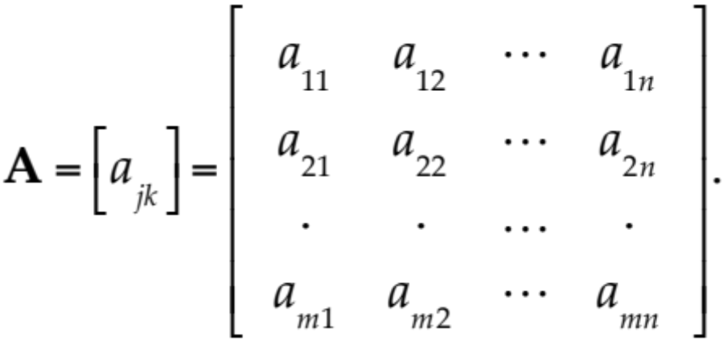
Matrix – Notations
We shall denote matrices by capital boldface letters A, B, C, … , or by writing the general entry in brackets; thus A = [a_{jk}], and so on.
By an m × n matrix (read m by n matrix) we mean a matrix with m rows and n columns—rows always come first! m × n is called the size of the matrix. Thus an m × n matrix is of the form
(2)

Slide 6
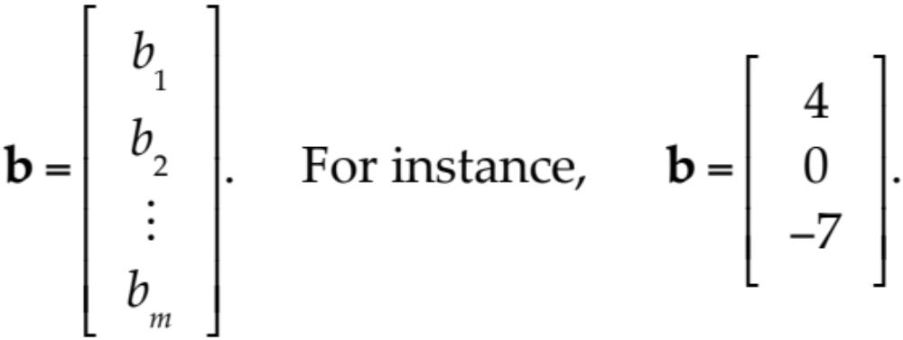
Vectors
A vector is a matrix with only one row or column. Its entries are called the components of the vector.
We shall denote vectors by lowercase boldface letters a, b, … or by its general component in brackets, a = [a_{j}], and so on. Our special vectors in (1) suggest that a (general) row vector is of the form
A column vector

Slide 7
Equality of Matrices
Two matrices A = [a_{jk}] and B = [b_{jk}] are equal, written A = B, if and only if (1) they have the same size and (2) the corresponding entries are equal, that is, a₁₁ = b₁₁, a₁₂ = b₁₂, and so on.
Matrices that are not equal are called different. Thus, matrices of different sizes are always different.

Slide 8
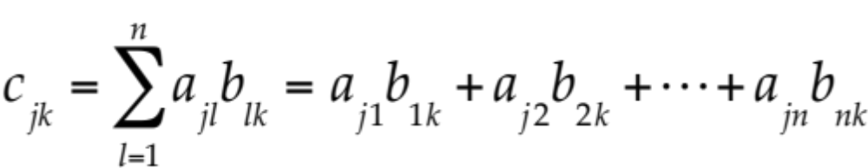
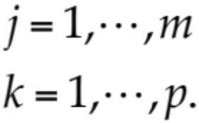
Matrix Multiplication
Multiplication of a Matrix by a Matrix
The product C = AB (in this order) of an m × n matrix A = [a_{jk}] times an r × p matrix B = [b_{jk}] is defined if and only if r = n and is then the m × p matrix C = [c_{jk}] with entries
(3)
The condition r = n means that the second factor, B, must have as many rows as the first factor has columns, namely n. A diagram of sizes that shows when matrix multiplication is possible is as follows:
A B = C
[m × n] [n × p] = [m × p].

Slide 9
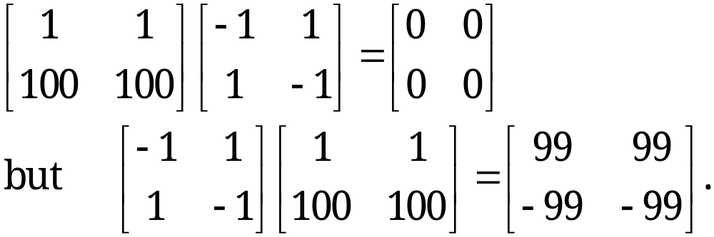
Matrix Multiplication
Matrix Multiplication Is Not Commutative, AB ≠ BA in General
It is interesting that this also shows that AB = 0 does not necessarily imply BA = 0 or A = 0 or B = 0.

Slide 10
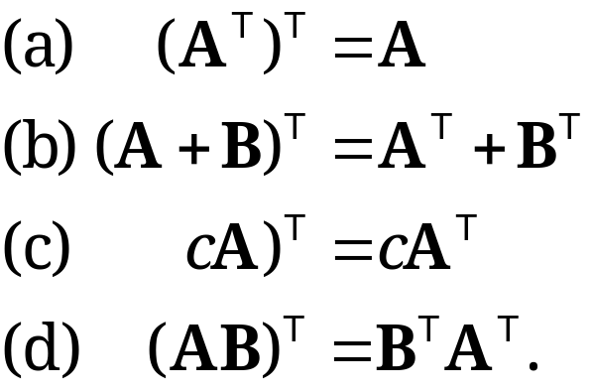
Transposition of Matrices & Vectors
The transpose of an m × n matrix A = [a_{jk}] is the n × m matrix A^{T} (read A transpose) that has the first row of A as its first column, the second row of A as its second column, and so on.
As a special case, transposition converts row vectors to column vectors and conversely.
Rules of transposition
Notes:
Dimensions of A^{T} are the reverse of dimension of A

Slide 11
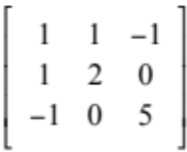
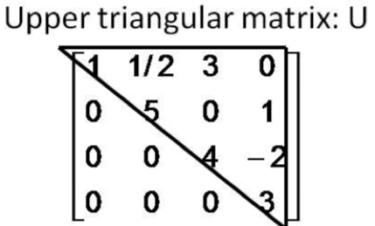
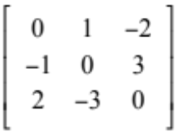
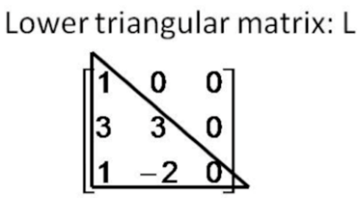
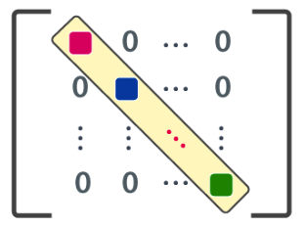
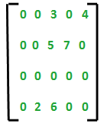
Special Matrices
Symmetric: a_{ij} = a_{ji} Eg:
Skew Symmetric : a_{ij} = - a_{ji} Eg:
Triangular: Upper Triangular → a_{ij} = 0 for all i > j
Lower Triangular → a_{ij} = 0 for all i < j
Diagonal Matrix: a_{ij} = 0 for all i ≠ j Eg:
Sparse Matrix: Many zeroes and few non-zero entities
Orthogonal matrix: A such that A^{T} = A⁻¹
Notes:
Symmetric : A^{T} = A
Skew Symmetric A^{T} = - A

Slide 12
Elementary Row Operations
Interchange of two rows
Addition of a constant multiple of one row to another row
Multiplication of a row by a nonzero constant c
CAUTION! These operations are for rows, not for columns!

Slide 13
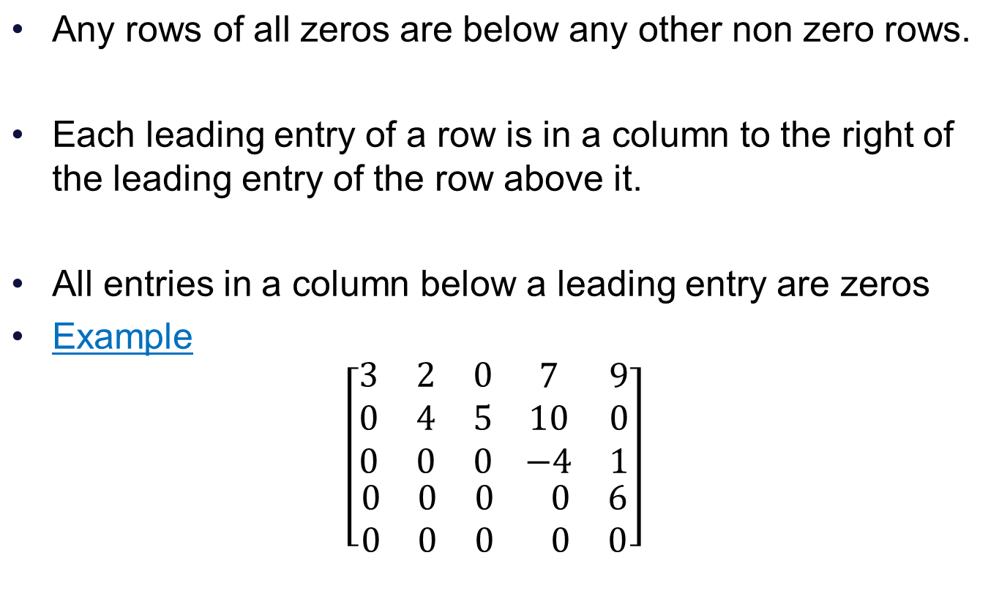
Row Echelon Form (REF) of a matrix

Slide 14

Row Reduced Echelon Form (RREF)
We say that a matrix is in Reduced Row Echelon Form if it is in Echelon form and additionally,
1. The leading entry in each row is 1.
2. Each leading 1 is the only non zero entry in its column

Slide 15
Uniqueness of Row Reduced Echelon Form
We can transform any matrix into a matrix in reduced echelon form by using elementary row operations.
No matter what sequence of row operations we use each matrix is row equivalent to one and only one reduced echelon matrix

Slide 16
Rank of a Matrix
Definition
The rank of a matrix A is the number of non-zero row in the RREF of A.
It is denoted by rank A.
We call a matrix A₁ row-equivalent to a matrix A₂ if A₁ can be obtained from A₂ by (finitely many!) elementary row operations.
Theorem 1
Row-equivalent matrices have the same rank.

Slide 17
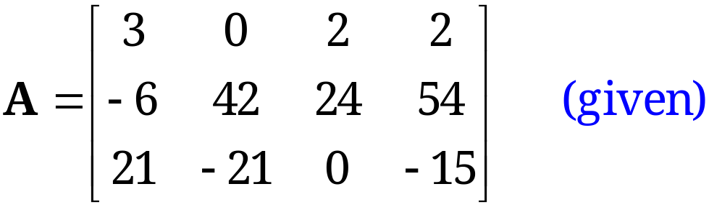
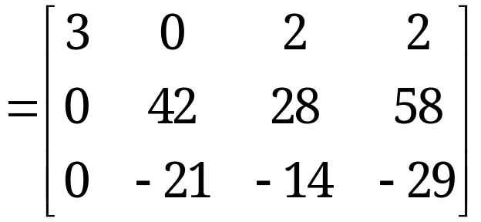
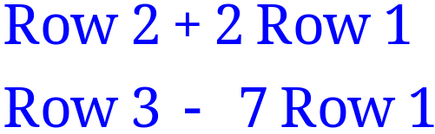
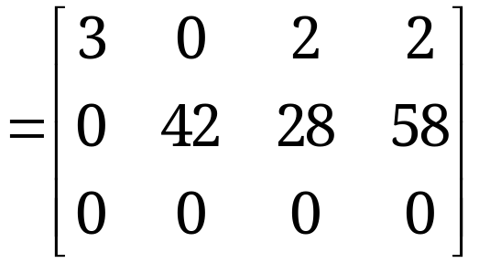

Determination of Rank
The last matrix is in row-echelon form and has two nonzero rows. Hence rank A = 2.

Slide 18
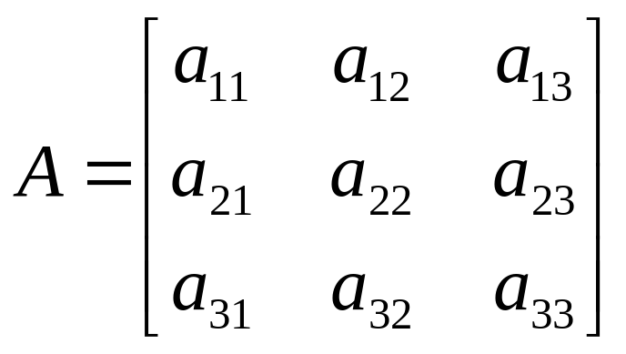
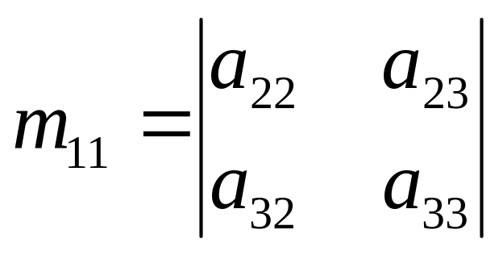
Minor
Each element in A has a minor
Delete first row and column from A .
The determinant of the remaining 2 x 2 submatrix is the minor of a₁₁

Slide 19

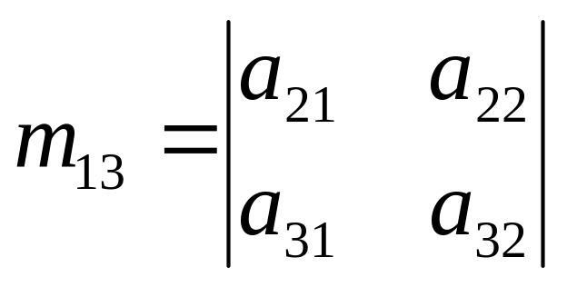
Minor
And the minor for a₁₃ is:

Slide 20
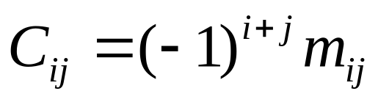
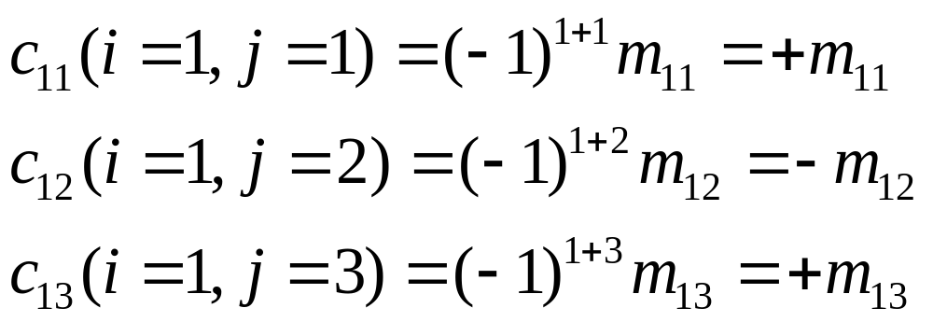
Cofactor
The cofactor C_{ij} of an element a_{ij} is defined as:
When the sum of a row number i and column j is even, c_{ij} = m_{ij} and when i+j is odd, c_{ij} =-m_{ij}

Slide 21
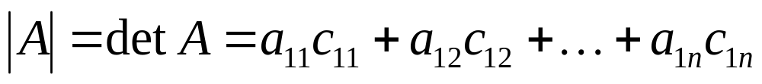
Determinant
The determinant of an n x n matrix A can now be defined as
The determinant of A is therefore the sum of the products of the elements of the first row of A and their corresponding cofactors.
(It is possible to define |A| in terms of any other row or column but for simplicity, the first row only is used)

Slide 22
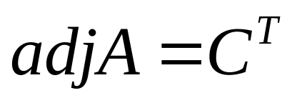
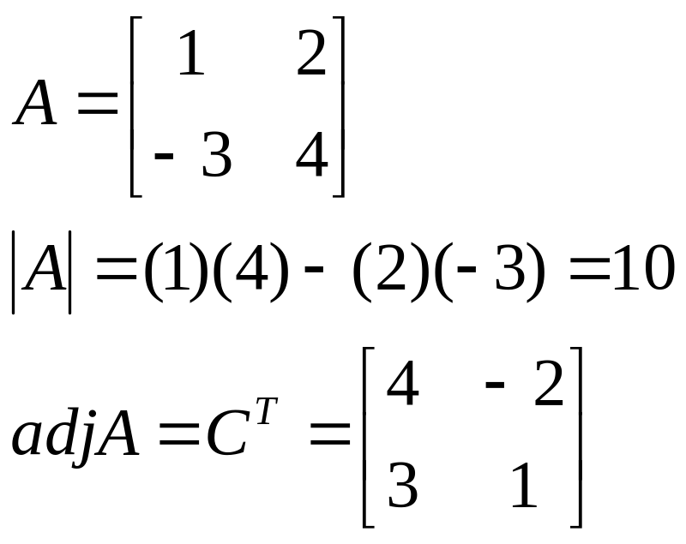
Adjoint
The adjoint matrix of A, denoted by adj A, is the transpose of its cofactor matrix
It can be shown that:
A(adj A) = (adjA) A = |A| I
Example:

Slide 23
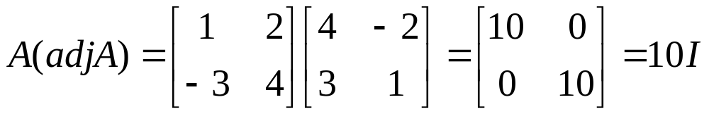
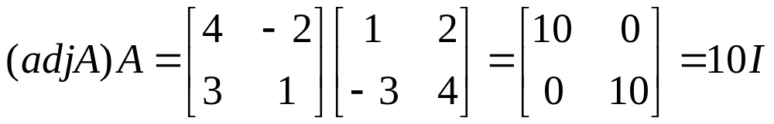
Adjoint

Slide 24
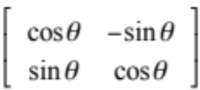
Properties of Determinants
det(AB) =det(A) * det (B)
det(A) nonzero implies there exists a matrix B such that AB=BA=I
Two Rows Equal➔ det = 0(Singular)
R_{i} and R_{j} swapped ➔ det gets a minus sign (i ≠ j)
det(A) = det(A^{T})
R_{i} ← cR_{j} ➔det A ←c detA
Orthogonal matrices: det(A) = -1 or 1
Notes:
6.Multiplication of a row by c multiplies the value of determinant by c

Slide 25
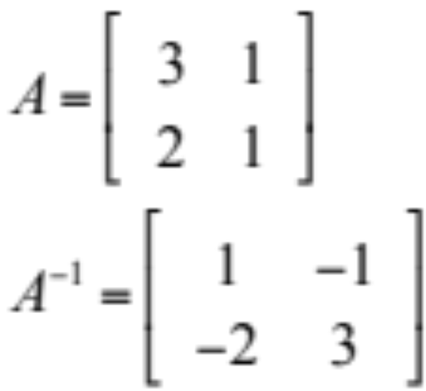
Inverse
A⁻¹ = adj(A) where det(A) ≠ 0
det(A)
Reiterate det(A) ≠ 0 → A is Non singular

Slide 26
Inverse
The result can be checked using
AA⁻¹ = A⁻¹A = I
The determinant of a matrix must not be zero for the inverse to exist as there will not be a solution
Non-singular matrices have non-zero determinants
Singular matrices have zero determinants

Slide 27
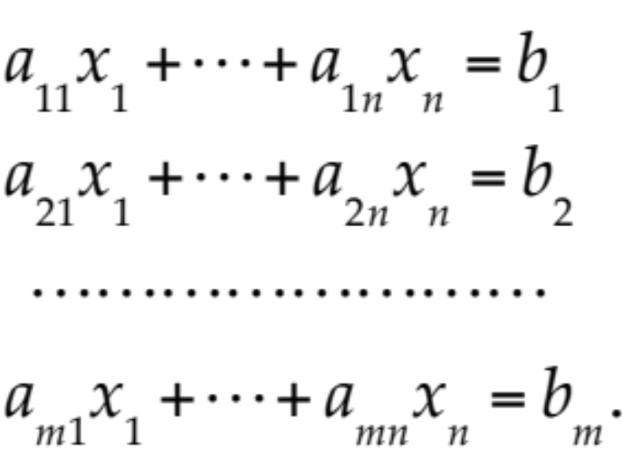
Linear System
A linear system of m equations in n unknowns x₁, … , x_{n} is a set of equations of the form
(1)
The system is called linear because each variable x_{j} appears in the first power only, just as in the equation of a straight line.

Slide 28
Linear System
(1)
a₁₁, … , a_{mn} are given numbers, called the coefficients of the system.
b₁, … , b_{m} on the right are also given numbers.
If all the bj are zero, then (1) is called a homogeneous system.
If at least one bj is not zero, then (1) is called a non-homogeneous system.

Slide 29
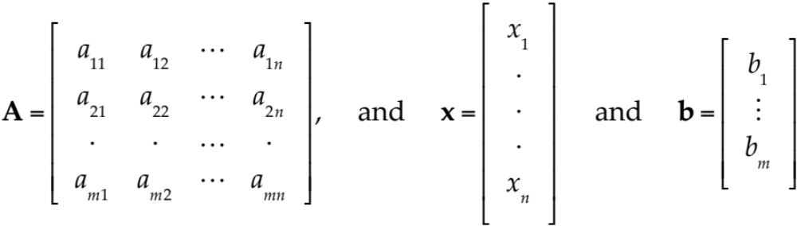
Coefficient Matrix
Matrix Form of the Linear System (1).
From the definition of matrix multiplication we see that the m equations of (1) may be written as a single vector equation
Ax = b (2)
where the coefficient matrix A = [a_{jk}] is the m × n matrix
are column vectors.

Slide 30
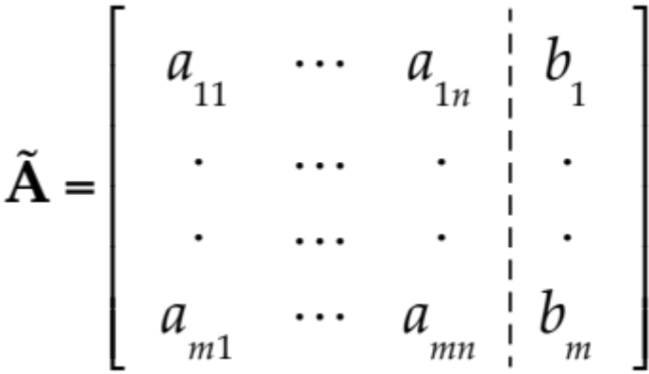
Matrix Form of Linear System
Matrix Form of the Linear System (1). (continued)
We assume that the coefficients a_{jk} are not all zero, so that A is not a zero matrix. Note that x has n components, whereas b has m components. The matrix
is called the augmented matrix of the system (1).
The dashed vertical line could be omitted, as we shall do later. It is merely a reminder that the last column of Ã did not come from matrix A but came from vector b. Thus, we augmented the matrix A.

Slide 31
Solution to System of Linear Equations
A linear system (1) is called overdetermined if it has more equations than unknowns, determined if m = n, and underdetermined if it has fewer equations than unknowns.
A linear system is consistent if rank(A) = rank(A|b)
A consistent system has at least one solution (thus, one solution or infinitely many solutions), but inconsistent has no solutions at all, as x₁ + x₂ = 1, x₁ + x₂ = 0.

Slide 32
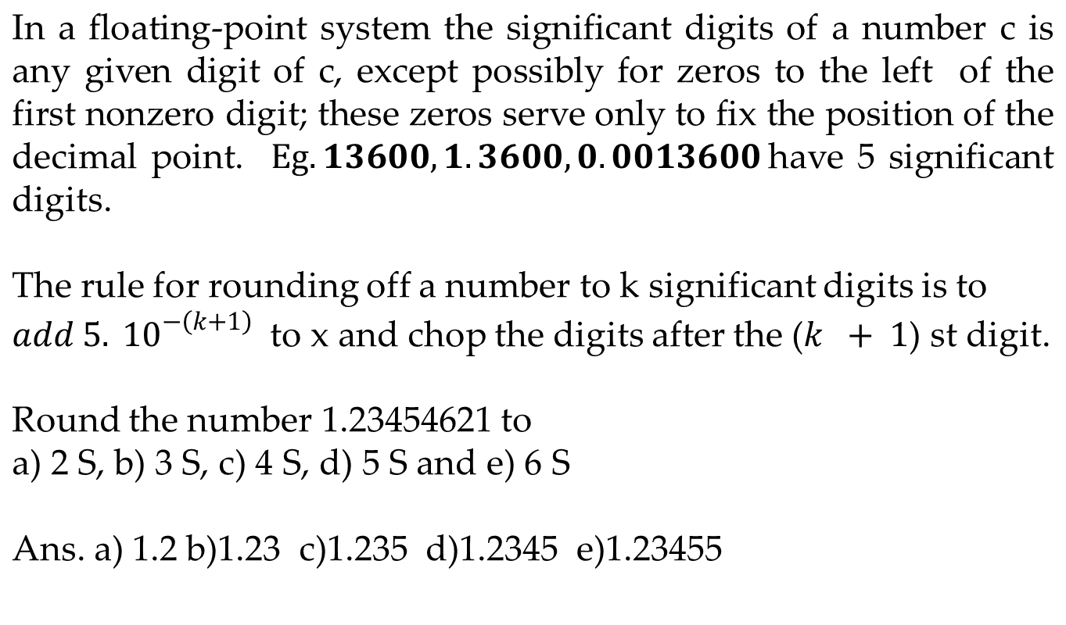
Significant digits

